Slide 1
ELEN 21/COEN 21: Introduction to Logic Design
Lectures 17 & 18: PLDs and Transistors
Radhika S. Grover
Electrical Engineering Department
Santa Clara University
rgrover@scu.edu

Slide 2
Overview
Overview:
Programmable devices: PLA, PAL, CPLD, FPGA
NMOS, PMOS transistors
CMOS transistors
Building gates from transistors
Voltage-current relationship
Noise margin
Power dissipation

Slide 3
Fixed vs. Programmable logic
Two types of logic devices
Fixed devices:
Permanent
Function cannot be changed after manufacture
Large times to go from design, prototyping to manufacture
e.g. 7400-series
Programmable devices:
Customers can program the function into the device.
Easy to develop and test.
Examples: PAL, PLA, CPLD, FPGA

Slide 4
PLDs
Types of PLDs:
PROM: fixed AND array, programmable OR array
PAL: programmable AND array, fixed OR array
Easier to program but not as flexible as PLA
PLA: programmable AND array, programmable OR array
Does not generate all the minterms unlike PROM
Typical PLA has a large number of inputs and product terms
Programmed using computer-aided design programs and FPLA programmer

Slide 5
Programmable Arrays
Inputs
Array of AND gates
Product terms
Array of OR gates
Outputs

Slide 6
PLA (Programmable Logic Array) Connections
A
B
Usually, PLAs are shown by replacing multiple lines connected to one gate by a single line.
Outputs

Slide 7
Example
Suppose that we want to implement the functions F1 and F2 on a PLA:
F1 = AB’ + AC + A’BC’
F2 = (AC + BC)’
Note that product term AC is shared.

Slide 8
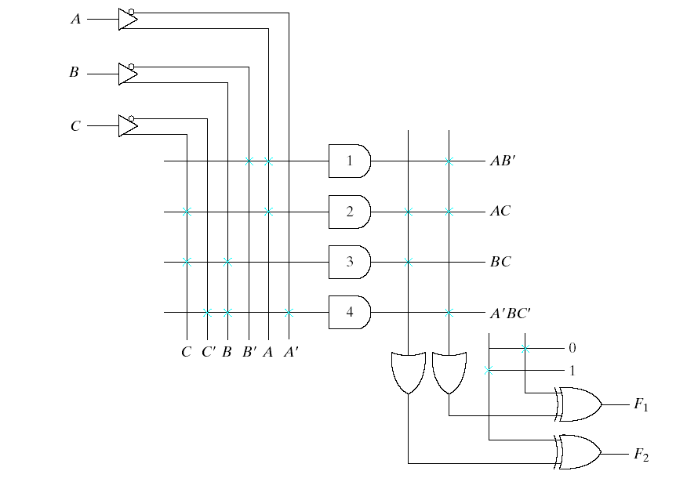
PLA
Initially, all fuses are connected.
After programming, unwanted fuses are blown out.
Points where fuse is intact are shown with X.

Slide 9
PLA Programming Table
Input side
1 = asserted
0 = not asserted
- = not used
Output side
1 =term connected to output
- = not used in output
Product term Inputs Outputs
A B C F1 F2
T C
1 1 0 - 1 -
2 1 - 1 1 1
3 - 1 1 - 1
4 0 1 0 1 -
AB’
AC
BC
A’BC’
T: represents true
C: represents complement

Slide 10
Exercise
Implement the following functions on a PLA:
F1 = ABC
F2 = A + B + C
F3 = A xor B xor C

Slide 11
PAL (Programmable Array Logic)
AND array is programmable, OR array is fixed at fabrication time.
A
B
PAL representation
A
B
Outputs

Slide 12
Exercise
Implement the following BCD to Gray code converter in a PAL:
A B C D F G H I
0 0 0 0 0 0 0 0
0 0 0 1 0 0 0 1
0 0 1 0 0 0 1 1
0 0 1 1 0 0 1 0
0 1 0 0 0 1 1 0
0 1 0 1 1 1 1 0
0 1 1 0 1 0 1 0
0 1 1 1 1 0 1 1
1 0 0 0 1 0 0 1
1 0 0 1 1 0 0 0
1 0 1 0 X X X X
1 0 1 1 X X X X
1 1 0 0 X X X X
1 1 0 1 X X X X
1 1 1 0 X X X X
1 1 1 1 X X X X
Assume that there are 4 product terms for each OR gate
Notes:
Solution:
F = A + B D + B C
G = B C'
H= B + C
I= A'B'C'D + B C D + A D' + B' C D'
Assume that there are 4 product terms for each OR gate
The first OR gate has the output:
F=A + BD + BC + 0
All AND gates that have output 0 have all fuses left intact.
Similarly, G = BC’+0+0+0

Slide 13
Other Programmable Devices
CPLD : Complex programmable logic device
Collection of individual PLDs on a single integrated circuit.
A programmable interconnect structure allows the PLDs to be connected to each other.
FPGA (Field programmable gate array) : VLSI circuit that can be programmed in user’s location any number of times.
Consists of an array of hundreds or thousands of logic blocks surrounded by programmable input or output blocks.
A FPGA logic block consists of look-up tables, muxes, gates and flip-flops.
Look-up table is a truth table stored in a SRAM and provides the combinational circuit functions for the logic block.

Slide 14
CPLD structure
I/O block
PAL-like
PAL-like
block
block
I/O block
Programmable switches to connect the blocks
Interconnection wires
Connected to input and output pins
I/O block
PAL-like
PAL-like
block
block
I/O block
Notes:
Can have 2 to more than 100 PAL-like blocks

Slide 15
FPGA
Can be programmed by the user after the FPGA is manufactured.
Advantages:
Ease of use
Parallelism
Good for prototyping
Applications:
ASIC prototyping
Digital signal processing
Medical imaging
Speech recognition
Cryptography and many others

Slide 16
FPGA Architecture
Configurable Logic Blocks
Configurable Routing channels
Programmable switch boxes

Slide 17
Configurable Logic Block (CLB)
CLBs contain a 4-input or 6-input Look-up-table (LUT) that can be used to implement Boolean functions:
4-input Look-up Table
D flip-flop
mux

Slide 18
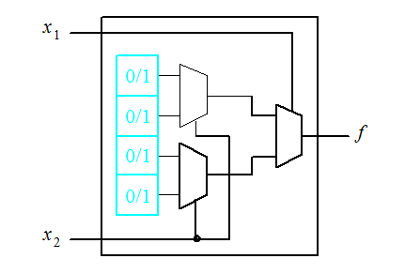
Generic Look-up table (LUT)
Uses muxes
Uses memory

Slide 19
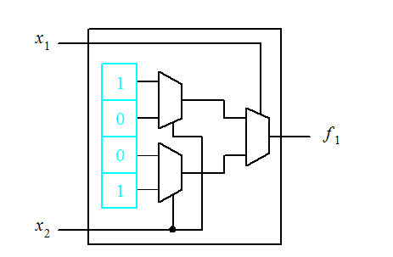
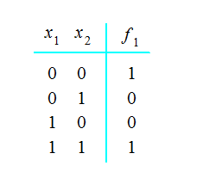
Implementing a Function in a LUT
This function is implemented in the LUT on the right

Slide 20
Standard Cells
Group of transistors and interconnects that implement boolean functions and storage functions (such as AND, OR, XOR, flip-flops, latches, muxes, adders etc)
Initial design is developed as a transistor netlist.
SPICE simulations are used to determine if the netlist works correctly, and predict the power consumption, propagation delay and other parameters.

Slide 21
Implementing Functions with Standard Cells
Blue & black lines represent different layers of metal wires.
Notes:
0.6 micron has3 metal layers: M1 for within cell routing, M2 for vertical routing between cells, M3 for horizontal routing

Slide 22
Sea-of-gates Gate Array
Gates are placed in matrix form without interconnections.
Users complete design by fabricating wires to connect the gates together.
Requires less area and delay than PLAs.

Slide 23
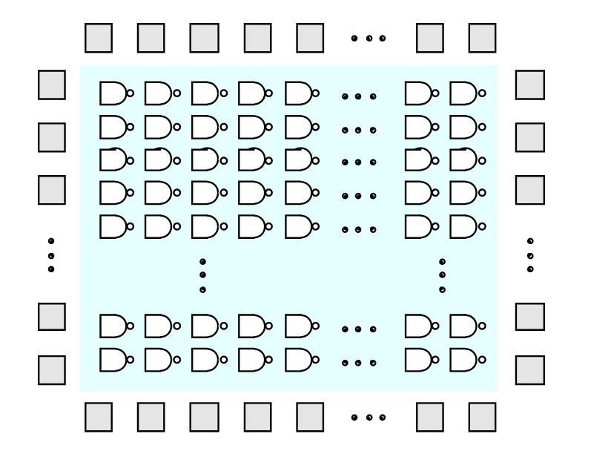
Sea-of-gates Gate Array

Slide 24
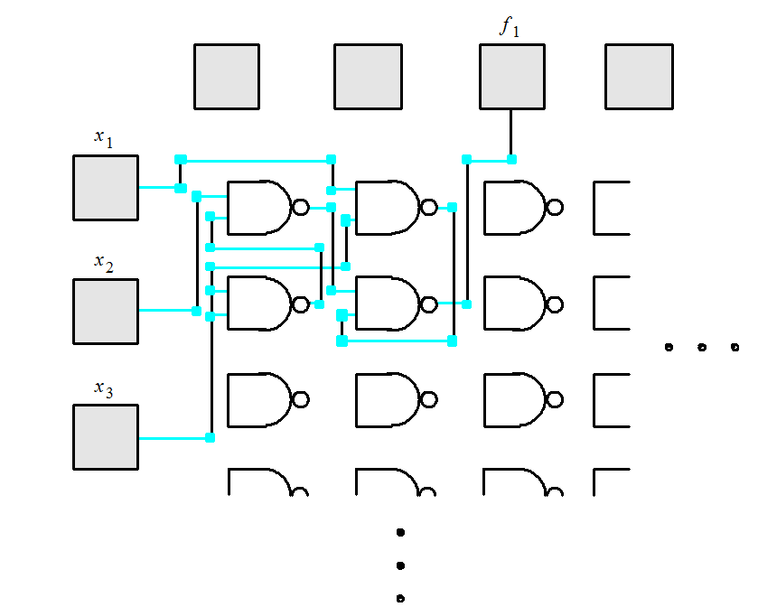
Implementing a Function using Sea-of-gates Gate Array

Slide 25
Building Gates from Transistors
Logic circuits are built from transistors.
There are two types of transistors: NMOS and PMOS.
V
DD
R
x
f
V
f
(c) Graphical symbols
V
x
Simplified circuit diagram

Slide 26
NMOS transistor
V
D
V
D
= 0 V
V
D
V
G
V
S
= 0 V
Closed switch
Open switch
when
V
G
=
V
DD
when
V
G
= 0 V
(a) NMOS transistor

Slide 27
PMOS transistor
V
S
=
V
DD
V
DD
V
DD
V
G
V
D
V
D
V
D
=
V
DD
Open switch
Closed switch
when
V
G
=
V
DD
when
V
G
= 0 V
(b) PMOS transistor

Slide 28
A CMOS NOT gate
V
DD
T
1
V
x
V
f
x
T
1
T
2
f
T
2
0
on
off
1
1
off
on
0
(a) Circuit
(b) Truth table and transistor states
Notes:
CMOS inverter:
If Vx = 0 V, transistor T2 is off and T1 is on. This makes Vf = 5 V and since T2 is off, no current flows through the transistors.
If Vx = 5 V, T2 is on and T1 is off. This makes Vf = 0 V and no current flows because T1 is off.
Advantage of CMOS circuits: no current flows under steady state conditions (hence no power dissipation).

Slide 29
A CMOS NAND gate

Slide 30
A CMOS NOR gate

Slide 31
NMOS
V
=
0
V
G
SiO
2
V
=
0
V
S
V
D
++++++
++++
++++++
++++++
+++
++++++
++++++
++++++
++++++
++++++
+++++++++++
++++++
++++++
+++++++++++
+++++++++
Substrate (type p)
+++++++++
Source (type n)
Drain (type n)
(a) When
V
GS
= 0 V, the transistor is off
Notes:
An extrinsic semiconductor is a semiconductor that has been doped, that is, into which a doping agent has been introduced, giving it different electrical properties than the intrinsic (pure) semiconductor. During doping, impurity atoms are introduced to an intrinsic semiconductor. Impurity atoms are atoms of a different element than the atoms of the intrinsic semiconductor. Impurity atoms act as either donors or acceptors to the intrinsic semiconductor, changing the electron and hole concentrations of the semiconductor. Impurity atoms are classified as donor or acceptor atoms based on the effect they have on the intrinsic semiconductor.
Extrinsic semiconductors with a larger electron concentration than hole concentration are known as n-type semiconductors. The phrase 'n-type' comes from the negative charge of the electron. In n-type semiconductors, electrons are the majority carriers and holes are the minority carriers.
As opposed to n-type semiconductors, p-type semiconductors have a larger hole concentration than electron concentration. The phrase 'p-type' refers to the positive charge of the hole. In p-type semiconductors, holes are the majority carriers and electrons are the minority carriers.

Slide 32
NMOS
V
DD
V
G
=
5
V
SiO
2
V
S
=
0
V
V
D
=
0
V
++++++
++++
+++
++++++
++++++
++++++
+++++++++++
+++++++++++++++++
+++++++++
++
+++++++
++++++++++
Channel (type n)
(b) When
V
GS
= 5 V, the transistor is on
Notes:
The gate is like a switch. When a positive voltage is applied to gate, the electrons are drawn into the channel and the current flows as a result.

Slide 33
Voltage Current Relationship
Linear region: Vds<(Vgs-Vt)
Id =kW[(Vgs-Vt)Vds-Vds²/2]/L
Saturation
Id=kW(Vgs-Vt)²/(2L)
Id=current from source to drain
k=constant depends on technology
Vgs=gate-to-source voltage
Vt=0.2Vdd (Vdd=5 Volts)
Vds=drain-to-source voltage
W,L=channel width and length

Slide 34
Voltage-current relationship in NMOS transistor
Triode
Saturation
0
V
–
V
V
GS
T
DS

Slide 35
Noise Margin
Noise margin is the amount of voltage fluctuation that a circuit can tolerate on its inputs without changing its output.
High level noise margin = minimum high output voltage –minimum high input voltage
Low level noise margin = maximum low input voltage –maximum low output voltage

Slide 36
Noise Margin
Logical high output range
V_{DD}
V_{DD}
Logical high input range
V_{OH}
NM_{H}
V_{IH}
V_{OL}
NM_{L}
V_{IL}
Logical low output range
Logical low input range
0
0

Slide 37
Power Dissipation
Dynamic power consumed Pd=fCVdd²
f=switching frequency
C=power dissipation capacitance
Vdd=power supply voltage

Slide 38
Summary
Different types of PLDs
Differences between PALs and PLAs
Implementing simple logic functions using PLDs
FPGAs

